Slide 1
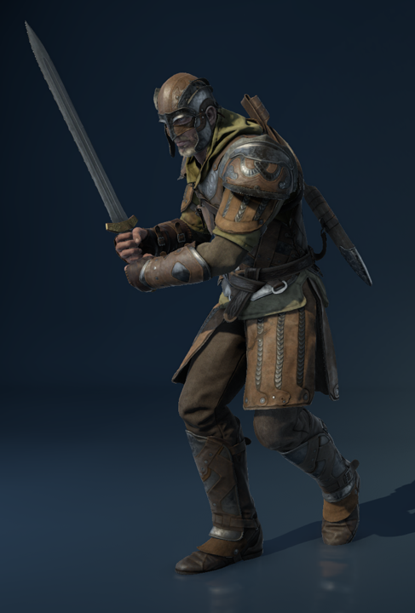
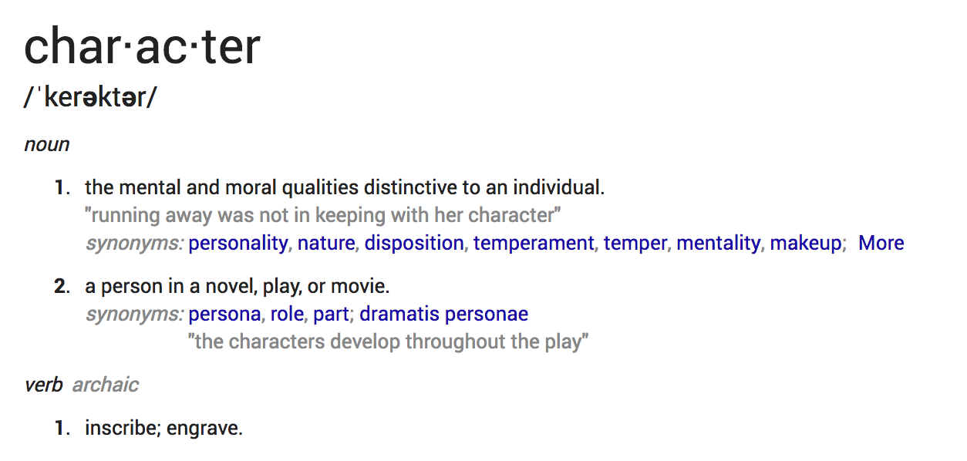
What is a Character?

Slide 2
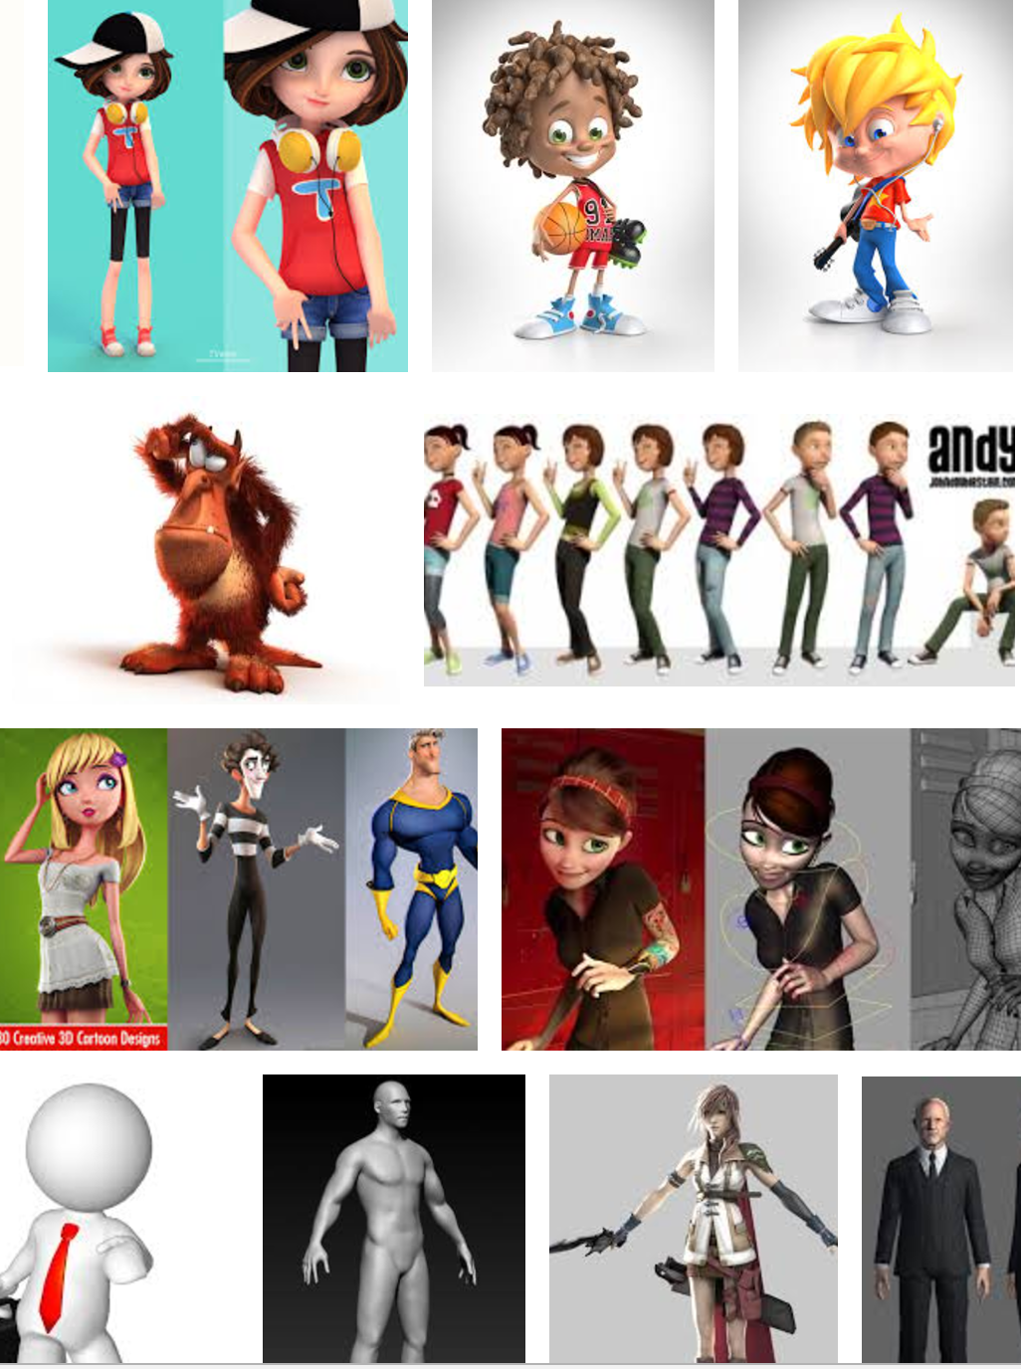
What is a Character?
VR Character is:
An object in the experience that resembles a living creature, most-often human, that a player can interact with.
Vital to storytelling and engagement

Slide 3
But what MAKES Character?
VR Character is:
An object in the experience that resembles a living creature, most-often human, that a player can interact with.
Vital to storytelling and engagement

Slide 4
But what MAKES a Character?
Unique but relatable
Think Tom Hanks
Captain John Miller,
Woody,
Forest Gump,

Slide 5
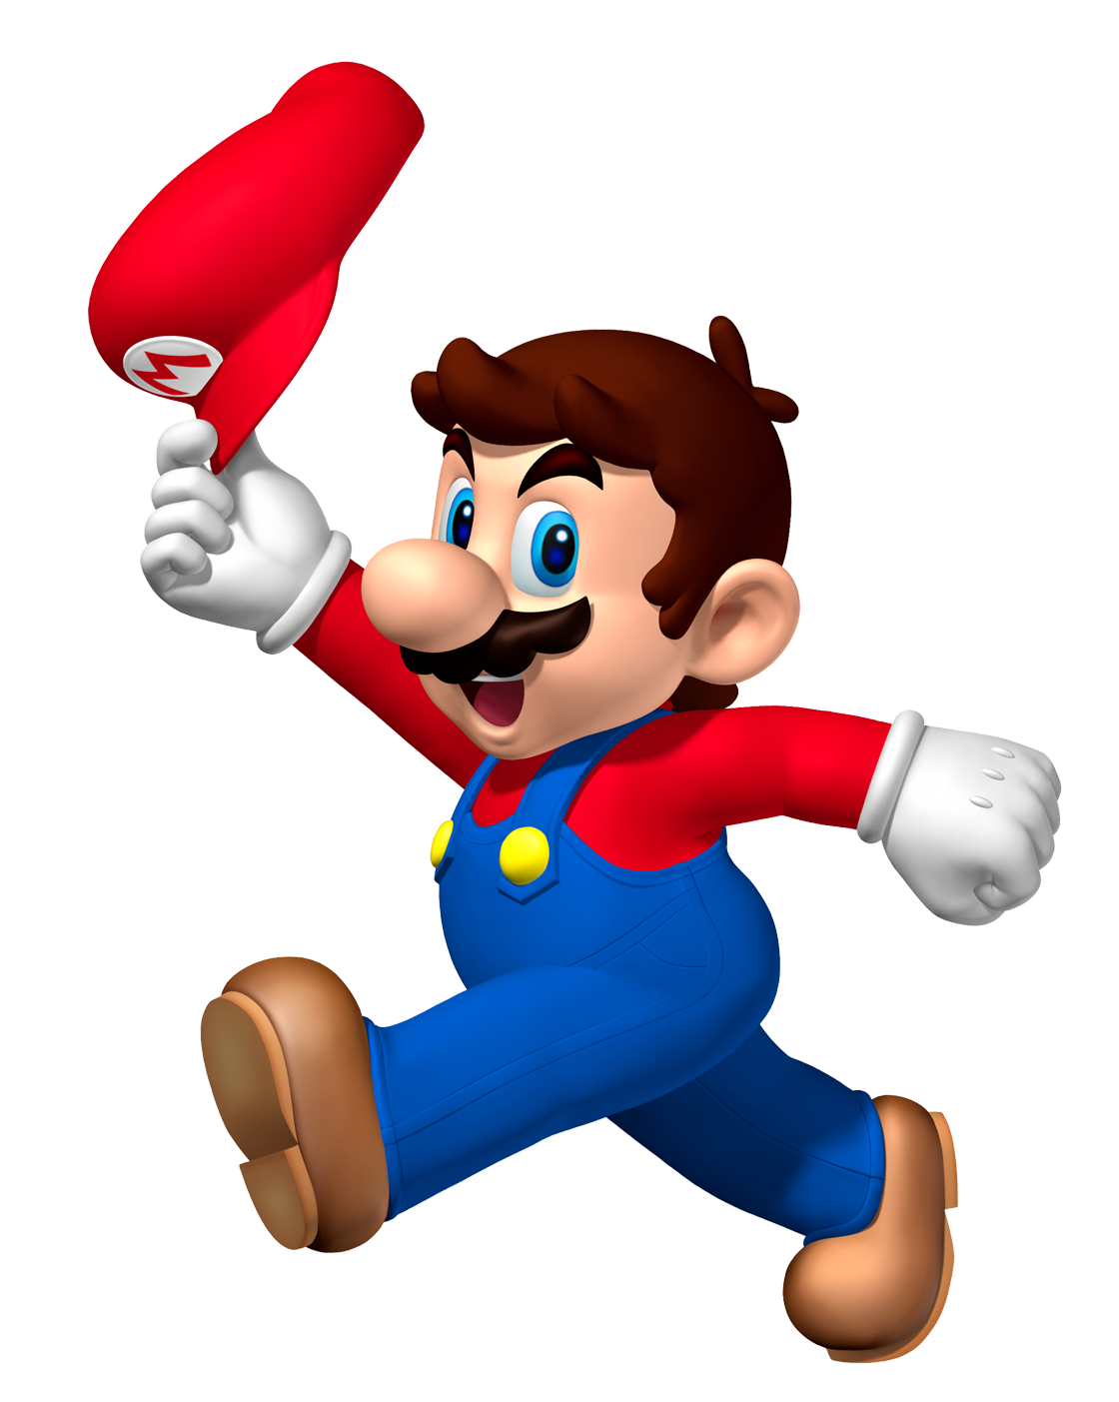
But what MAKES a Character?
Unique but relatable
Think Tom Hanks
Captain John Miller, Woody, Forest Gump
CLICHÉ

Slide 6
But what MAKES a Character?
Unique but relatable
Think Tom Hanks
Captain John Miller, Woody, Forest Gump
CLICHE

Slide 7
But what MAKES a Character?
Unique but relatable
Think Tom Hanks
Captain John Miller, Woody, Forest Gump
CLICHÉ = SIMPLE

Slide 8
But what MAKES a Character?
Unique but relatable
Think Tom Hanks
Captain John Miller, Woody, Forest Gump,
Powerful but flawed
Ironman, Jack Sparrow

Slide 9
But what MAKES a Character?
Unique but relatable
Think Tom Hanks
Captain John Miller, Woody, Forest Gump,
Powerful but flawed
Ironman, Jack Sparrow
Conflict, Strife and Opinions
Must have one but three are better.

Slide 10
Character Introduction
How do we meet the character?
What can we learn about the character?

Slide 11
The narrative is driven by the characters
~Steven King

Slide 12
__who__ did __what__ because______.
Frank gave away his favorite book because he felt compassion and it was all he had to give.

Slide 13
Generating Characters

Slide 14
Unity Characters

Slide 15
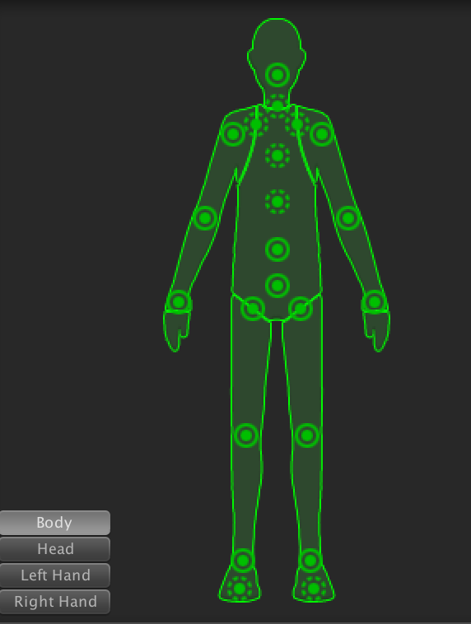
Rigged Characters
Prefab
Character
Avatar
Rig
15 Bones (humanoid)
Mesh
Animation Script
Animation

Slide 16
Where to get Rigged Characters
https://www.blendswap.com/
https://www.mixamo.com
https://www.turbosquid.com/

Slide 17
steven.king@unc.edu

